Slide 1
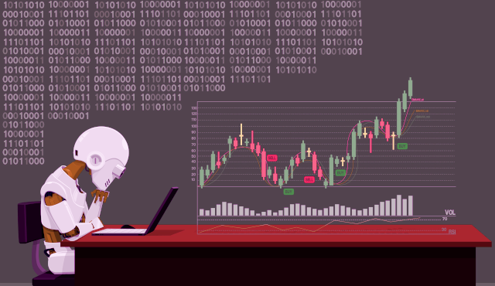

Slide 2
INTRODUCTION
Project: Predict future stock prices using Machine Learning (ML) and Artificial Intelligence (AI) to capitalize on the volatile nature of stock market trends.
Importance of Accurate Prediction: High accuracy in stock market trend prediction can result in significant revenue generation.

Slide 3
Objective
Develop a stock price prediction system integrating LSTM model and sentiment analysis for informed investment decisions.
Utilize mathematical functions and machine learning to enhance prediction accuracy and profitability.
Collect historical stock price data and textual sources for sentiment analysis.
Preprocess data, train LSTM model, and sentiment analysis module.
Integrate models into a cohesive prediction system for evaluation and testing.
Monitor system performance, refine models, and incorporate feedback.

Slide 4
Problem Definition
Stock market enables ownership of public companies via trading, offering potential prosperity with small initial investments and lower risks compared to entrepreneurship or high-income careers.
Market volatility arises from numerous influencing factors, leading to uncertainty; stock prices, being time-series data, exhibit high volatility.
Utilizing LSTM, the project aims to predict stock prices, leveraging its capability to capture long-term dependencies in sequential data.

Slide 5
PROPOSED WORK
The prediction methods can be roughly divided into two categories,
statistical methods and artificial intelligence methods.
Statistical methods : It include logistic regression model, ARCH model, etc.
Artificial intelligence methods: It include multi-layer perceptron, convolutional neural network, naive Bayes network, back propagation network, single-layer LSTM, support vector machine, recurrent neural network, etc. They used Long short-term memory network (LSTM).

Slide 6
LSTM
LSTM including Bidirectional-LSTM were tried to predict stock prices through us- age of Historical Close price values. Hyper parameter tuning was also carried out to arrive at the optimum results.
As indicated in the table below, LSTM is performing better as compared to other mod- els tried as part of the study. Thus, LSTM was selected for prediction of stock prices for other companies as well viz., HDFC Bank, SBI and TCS.
Models | RMSE
LSTM | 38.19
Bidirectional LSTM | 184.29
Linear Regression | 1030.83
Arima | 532.64
KNN | 1273.05
Prophet | 311.46
Random Forest Regressor | 580.49

Slide 7
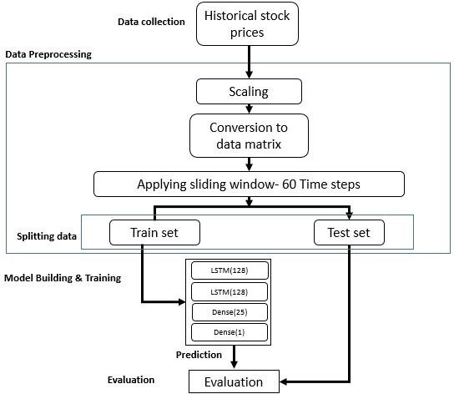
Proposed Work
SYSTEM ARCHITECTURE
Block diagram of stock prediction using LSTM

Slide 8
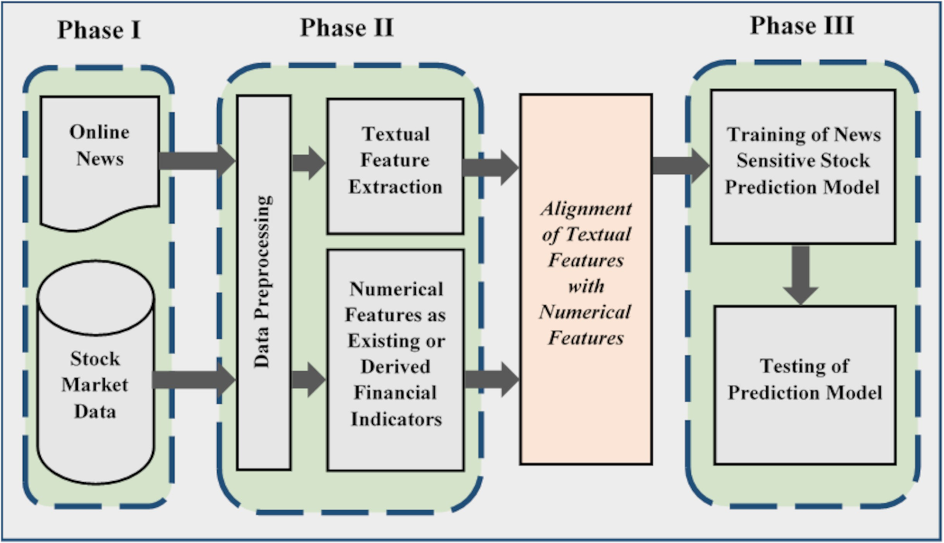
Generic methodology for news sensitive stock trend prediction

Slide 9
DATA SET
historical data downloaded from the Internet
For US Market based Stock :
we downloaded live datasets namely google,apple ,etc from the Yahoo Finance website (https://finance.yahoo.com/)
For Indian Market based Stock:
we downloaded live datasets namely Tata motor, nifty,banknifty ,etc from the NSE India website (https://www.nseindia.com/)

Slide 10
TOOL/PLATFORM USED
Software Requirements: • Python 3.6 in Google Colab is used for data pre-processing, model training and prediction. • Operating System: minimum windows 7 and above or Linux based OS or MAC OS

Slide 11
REFERENCES
https://www.youtube.com/
https://www.sciencedirect.com/science/article/pii/S1877050920307924
https://chat.openai.com/

Slide 12
Conclusion
Developed web app using LMS and LSTM algorithms for >trying to make above 95% accurate closing stock price prediction.
Studied stock trend prediction integrating news and stock prices, identifying challenges and opportunities.
Implemented a news-sensitive stock prediction model in three phases, reviewing existing literature for insights.

Slide 13


